Slide 1
Chapter 16: Query Optimization
Notes:
1）查询优化为什么要用到数据库的统计信息？2）数据库应用的运行会带来统计信息的变化，这对查询优化会产生怎样的影响？

Slide 2
Outline
Introduction
Transformation of Relational Expressions
Statistical Information for Cost Estimation
Cost-based Optimization
Dynamic Programming for Choosing Evaluation Plans
Nested Subqueries
Materialized Views
  Advanced Topics in Query Optimization

Slide 3
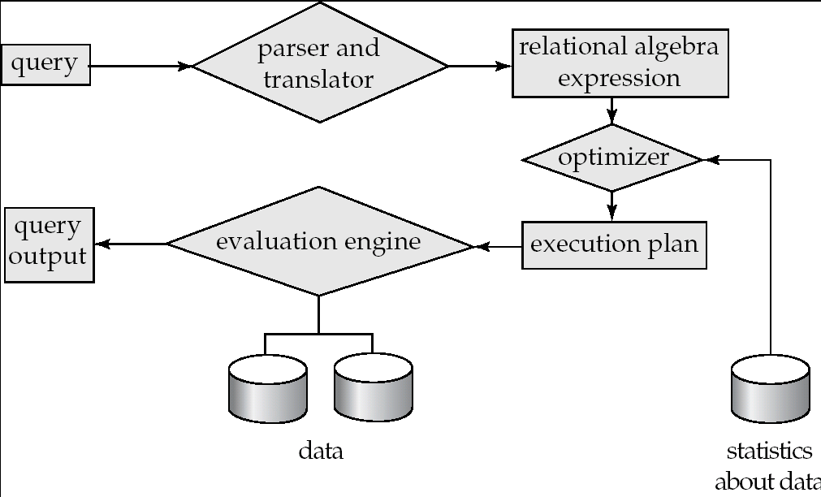
Introduction
Parsing and translation
  translate the query into its internal form. This is then translated into relational algebra.
  Parser checks syntax, verifies relations
  Optimization
  Amongst all equivalent evaluation plans choose the one with lowest cost.
Evaluation
  The query-execution engine takes a query-evaluation plan, executes that plan, and returns the answers to the query.
Basic Steps in Query Processing

Slide 4
Introduction
Alternative ways of evaluating a given query
  Equivalent expressions
  Different algorithms for each operation
  An analogy example:
  3.14* 35² + 3.14* 65²
  =3.14* (35² + 65²)
  = (35² + 65²) * 3.14 ← 逻辑优化，Transformation Based Optimization
  ← 物理优化，Cost Based Optimization
计算器
计算器
心算
心算

Slide 5
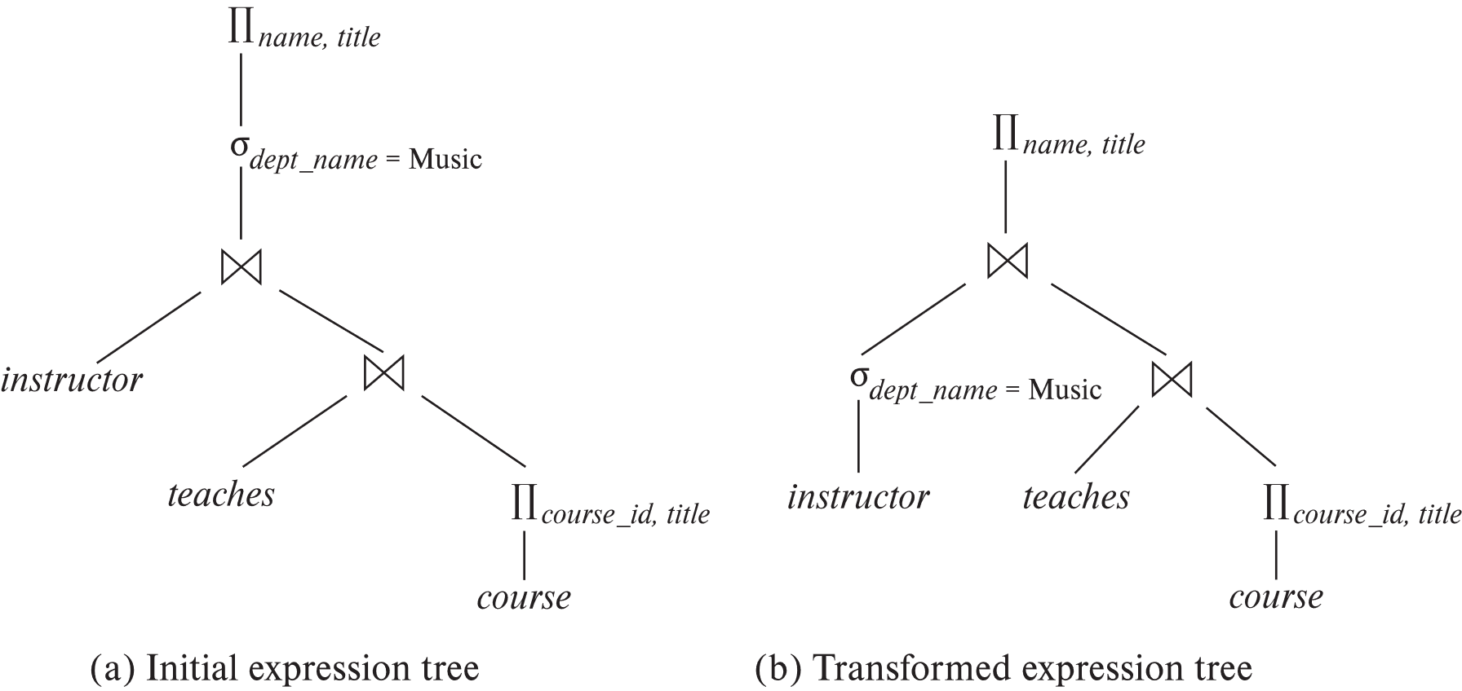
Introduction
  select name, title
  from instructor natural join (teaches natural join course)
  where dept_name=‘Music’ ;
Π_{name, title}(σ_{dept_name= “ Music”} (instructor (teaches (course))))
course

Slide 6
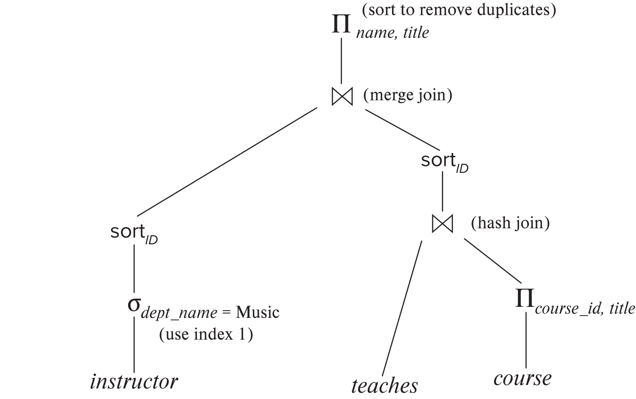
Introduction (Cont.)
An evaluation plan defines exactly what algorithm is used for each operation, and how the execution of the operations is coordinated.

Slide 7
Introduction (Cont.)
Cost difference between evaluation plans for a query can be enormous
  E.g. seconds vs. days in some cases
Steps in cost-based query optimization
  Generate logically equivalent expressions using equivalence rules
  Annotate resultant expressions in alternative ways to get alternative query plans
  Choose the cheapest plan based on estimated cost
Estimation of plan cost based on:
  Statistical information about relations. Examples:
    number of tuples, number of distinct values for an attribute
  Statistics estimation for intermediate results（Cardinality Estimation）
    to compute cost of complex expressions
  Cost formulae for algorithms, computed using statistics

Slide 8
Viewing Query Evaluation Plans
Most database support explain evaluation plan for a query
Some syntax variations between databases
  PostgreSQL : explain <query>
  Oracle: explain plan for <query> followed by select * from table (dbms_xplan.display)
  SQL Server: set showplan_text on
Some databases (e.g. PostgreSQL) support explain analyse <query>
  Shows actual runtime statistics found by running the query, in addition to showing the plan
Some databases (e.g. PostgreSQL) show cost as f..l
  f is the cost of delivering first tuple
  l is cost of delivering all results

Slide 9
Generating Equivalent Expressions

Slide 10
Transformation of Relational Expressions
Two relational algebra expressions are said to be equivalent if the two expressions generate the same set of tuples on every legal database instance
In SQL, inputs and outputs are multisets of tuples
  Two expressions in the multiset version of the relational algebra are said to be equivalent if the two expressions generate the same multiset of tuples on every legal database instance.
An equivalence rule says that expressions of two forms are equivalent
  Can replace expression of first form by second, or vice versa

Slide 11
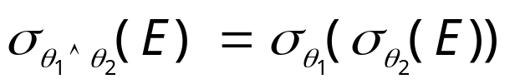


Equivalence Rules
1. Conjunctive selection operations can be deconstructed（分解） into a sequence of individual selections.
2. Selection operations are commutative（可交换的）.
3. Only the last in a sequence of projection operations is needed, the others can be omitted（可省略的）.
Selections can be combined with Cartesian products and theta joins.
  σ_{θ}(E₁ X E₂) = E₁ _{θ} E₂
  σ_{θ1}(E₁ _{θ2} E₂) = E₁ _{θ1∧ θ2} E₂

Slide 12
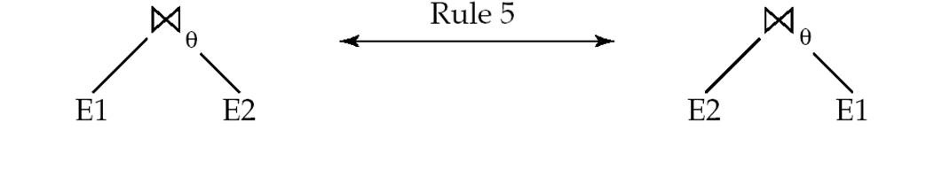
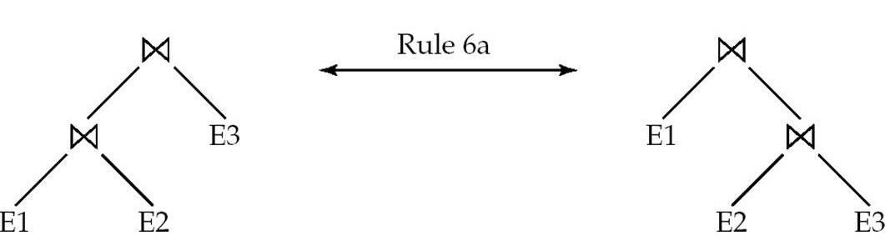
Equivalence Rules (Cont.)
Theta-join operations (and natural joins) are commutative（可交换的）.
E_{1 θ} E₂ = E₂ _{θ} E₁
6. (a) Natural join operations are associative（可结合的）:
(E₁ E₂) E₃ = E₁ (E₂ E₃)
(b) Theta joins are associative in the following manner:
(E_{1 θ1} E₂) _{θ2∧ θ3} E₃ = E_{1 θ1∧ θ3} (E₂ _{θ2} E₃)
where θ₂ involves attributes from only E₂ and E₃.

Slide 13
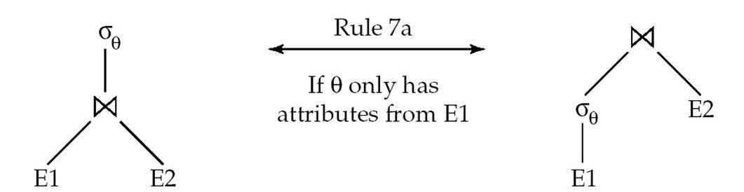
Equivalence Rules (Cont.)
The selection operation distributes（分配） over the theta join operation under the following two conditions:
(a) When all the attributes in θ₀ involve only the attributes of one of the expressions (E₁) being joined.
σ_{θ0}(E₁ _{θ} E₂) = (σ_{θ0}(E₁)) _{θ} E₂
(b) When θ ₁ involves only the attributes of E₁ and θ₂ involves
only the attributes of E₂.
σ_{θ1}∧_{θ2} (E₁ _{θ} E₂) = (σ_{θ1}(E₁)) _{θ} (σ_{θ2} (E₂))

Slide 14
Equivalence Rules (Cont.)
8. The projection operation distributes（分配） over the theta join operation as follows:
(a) if θ involves only attributes from L₁ ∪ L₂:
(b) Consider a join E_{1 θ} E₂.
  Let L₁ and L₂ be sets of attributes from E₁ and E₂, respectively.
  Let L₃ be attributes of E₁ that are involved in join condition θ, but are not in L₁ ∪ L₂, and
  let L₄ be attributes of E₂ that are involved in join condition θ, but are not in L₁ ∪ L₂.
∏
(
E
E
)
=
(
∏
(
E
))
(
∏
(
E
))
L
1
∪
L
2
1
θ
2
L
1
1
θ
L
2
2
∏
(
E
E
)
=
∏
((
∏
(
E
))
(
∏
(
E
)))
L
1
∪
L
2
1
θ
2
L
1
∪
L
2
L
1
∪
L
3
1
θ
L
2
∪
L
4
2

Slide 15
Equivalence Rules (Cont.)
The set operations union and intersection are commutative
E₁ ∪ E₂ = E₂ ∪ E₁
E₁ ∩ E₂ = E₂ ∩ E₁
  (set difference is not commutative).
Set union and intersection are associative.
(E₁ ∪ E₂) ∪ E₃ = E₁ ∪ (E₂ ∪ E₃)
(E₁ ∩ E₂) ∩ E₃ = E₁ ∩ (E₂ ∩ E₃)
The selection operation distributes over ∪, ∩ and –.
σ_{θ} (E₁ – E₂) = σ_{θ} (E₁) – σ_{θ}(E₂)
and similarly for ∪ and ∩ in place of –
Also: σ_{θ} (E₁ – E₂) = σ_{θ}(E₁) – E₂
and similarly for ∩ in place of –, but not for ∪
12. The projection operation distributes over union
Π_{L}(E₁ ∪ E₂) = (Π_{L}(E₁)) ∪ (Π_{L}(E₂))

Slide 16
Equivalence Rules (Cont.)
13. Selection distributes over aggregation as below
σ_{θ}(_{G}𝛾_{A}(E)) ≡ _{G}𝛾_{A}(σ_{θ}(E))
provided θ only involves attributes in G
14. a. Full outerjoin is commutative:
E₁ ⟗ E₂ ≡ E₂ ⟗ E₁
b. Left and right outerjoin are not commutative, but:
E₁ ⟕ E₂ ≡ E₂ ⟖ E₁
15. Selection distributes over left and right outer joins as below, provided θ₁
only involves attributes of E₁
a. σ_{θ1} (E₁ ⟕_{θ} E₂) ≡ (σ_{θ1} (E₁)) ⟕_{θ} E₂
b. σ_{θ1} (E₂ ⟖_{θ} E₁) ≡ E₂ ⟖_{θ} (σ_{θ1} (E₁))
16. Outerjoins can be replaced by inner joins under some conditions
a. σ_{θ1} (E₁ ⟕_{θ} E₂) ≡ σ_{θ1} (E₁ ⨝_{θ} E₂)
b. σ_{θ1} (E₁ ⟖_{θ} E₁) ≡ σ_{θ1} (E₁ ⨝_{θ} E₂)
provided θ₁ is null rejecting on E₂ ：
If θ1 has the property that it evaluates to false or unknown whenever
the attributes of E2 are null.

Slide 17
Equivalence Rules (Cont.)
Note that several equivalences that hold for joins do not hold for outerjoins
σ_{year=2017}(instructor ⟕ teaches) ≢ σ_{year=2017}(instructor ⨝ teaches)
Outerjoins are not associative
(r ⟕ s) ⟕ t ≢ r ⟕ (s ⟕ t)
  e.g. with r(A,B) = {(1,1), s(B,C) = { (1,1)}, t(A,C) = { }
Notes:
How about (r ⟕ s) ⟕ t vs (r ⟕ t) ⟕ s assuming r has common attributes with s and t? Hint: consider 2 cases where s and t have common attributes and those where they have no common attribute

Slide 18
Transformation Example: Pushing Selections
select name, title
    from instructor natural join (teaches natural join course)
    where dept_name=‘Music’
  Π_{name, title}(σ_{dept_name= “Music”} (instructor (teaches course)))
Transformation using rule 7a.
  Π_{name, title}((σ_{dept_name= “Music”}(instructor)) （teaches course))
Performing the selection as early as possible reduces the size of the relation to be joined.

Slide 19
Transformation Example: Pushing Projections
Consider:
Π_{name, title}(（σ_{dept_name= “Music”} (instructor) teaches） course)))
When we compute
(σ_{dept_name = “Music”} (instructor） teaches)
we obtain a relation whose schema is:
(ID, name, dept_name, salary, course_id, sec_id, semester, year)
Push projections using equivalence rules 8a and 8b; eliminate unneeded attributes from intermediate results to get:
Π_{name, title}(Π_{name, course_id} (
σ_{dept_name= “Music”} (instructor) teaches))
Π_{course_id, title} (course))))
Performing the projection as early as possible reduces the size of the relation to be joined.

Slide 20
Transformation Example - Join Ordering
For all relations r_{1,} r_{2,} and r₃,
(r₁ r₂) r₃ = r₁ (r₂ r₃ )
(Join Associativity)
If r₂ r₃ is quite large and r₁ r₂ is small, we choose
(r₁ r₂) r₃
so that we compute and store a smaller temporary relation.

Slide 21
Transformation Example - Join Ordering
Consider the expression
Π_{name, title}(σ_{dept_name= “Music”} (instructor) ((teaches)
Π_{course_id, title} (course) ) )
Could compute teaches Π_{course_id, title} (course) first, and join result with
σ_{dept_name= “Music”} (instructor)
but the result of the first join is likely to be a large relation.
Only a small fraction of the university’s instructors are likely to be from the Music department
  it is better to compute
σ_{dept_name= “Music”} (instructor) teaches
first.

Slide 22
Example with Multiple Transformations
Query: Find the names of all instructors in the Music department who have taught a course in 2017, along with the titles of the courses that they taught
  Π_{name, title}(σdept_name= “Music”∧year = 20017
  (instructor (teaches Π_{course_id, title} (course))))
Transformation using join associatively (Rule 6a):
  Π_{name, title}(σ_{dept_name= “Music”∧year = 2017}
  ((instructor teaches) Π_{course_id, title} (course)))
Second form provides an opportunity to apply the “perform selections early” rule, resulting in the subexpression
σ_{dept_name = “Music”} (instructor) σ _{year = 2009} (teaches)

Slide 23
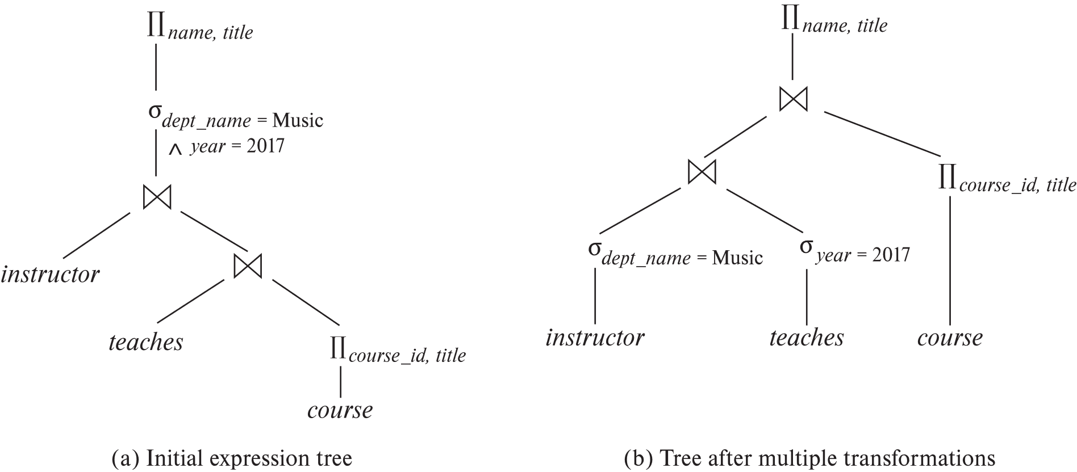
Multiple Transformations (Cont.)

Slide 24
Enumeration of Equivalent Expressions
Query optimizers use equivalence rules to systematically generate expressions equivalent to the given expression
Can generate all equivalent expressions as follows:
  Repeat
    apply all applicable equivalence rules on every subexpression of every equivalent expression found so far
    add newly generated expressions to the set of equivalent expressions
    Until no new equivalent expressions are generated above
The above approach is very expensive in space and time
  Two approaches
    Optimized plan generation based on transformation rules
    Special case approach for queries with only selections, projections and joins - heuristic manner .

Slide 25
Implementing Transformation Based Optimization
Space requirements reduced by sharing common sub-expressions:
  when E1 is generated from E2 by an equivalence rule, usually only the top level of the two are different, subtrees below are the same and can be shared using pointers
    E.g. when applying join commutativity
  Same sub-expression may get generated multiple times
    Detect duplicate sub-expressions and share one copy
Time requirements are reduced by not generating all expressions
  Dynamic programming
    We will study only the special case of dynamic programming for join order optimization
E1
E2

Slide 26
Statistics for Cost Estimation

Slide 27
Cost Estimation
Cost of each operator
  Need statistics of input relations
    E.g. number of tuples, sizes of tuples
Inputs can be results of sub-expressions
  Need to estimate statistics of expression results （cardinality estimation）
  To do so, we require additional statistics
    E.g. number of distinct values for an attribute

Slide 28

Statistical Information for Cost Estimation
n_{r}: number of tuples in a relation r.
b_{r}: number of blocks containing tuples of r.
l_{r}: size of a tuple of r.
f_{r}: blocking factor of r — i.e., the number of tuples of r that fit into one block.
V(A, r): number of distinct values that appear in r for attribute A; same as the size of ∏_{A}(r).
If tuples of r are stored together physically in a file, then:

Slide 29

Histograms
Histogram on attribute age of relation person
Equi-width histograms
Equi-depth histograms

Slide 30
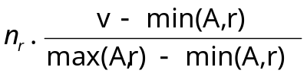
Selection Size Estimation
σ_{A=v}(r)
    n_{r} / V(A,r) : number of records that will satisfy the selection
    Equality condition on a key attribute: size estimate = 1
σ_{A≤V}(r) (case of σ_{A ≥ V}(r) is symmetric)
  Let c denote the estimated number of tuples satisfying the condition.
  If min(A,r) and max(A,r) are available in catalog
    c = 0 if v < min(A,r)
    c =
  If histograms available, can refine above estimate
  In absence of statistical information c is assumed to be n_{r} / 2.

Slide 31


Size Estimation of Complex Selections
The selectivity（中选率） of a condition θ_{i} is the probability that a tuple in the relation r satisfies θ_{i} .
  If s_{i} is the number of satisfying tuples in r, the selectivity of θ_{i} is given by s_{i} /n_{r}.
Conjunction: σ_{θ1∧ θ2∧. . . ∧ θn} (r). Assuming indepdence, estimate of
tuples in the result is:
Disjunction:σ_{θ1∨} _{θ2 ∨. . . ∨} _{θn} (r). Estimated number of tuples:
Negation: σ_{¬θ}(r). Estimated number of tuples:
n_{r} – size(σ_{θ}(r))

Slide 32
Estimation of the Size of Joins
The Cartesian product r x s contains n_{r} .n_{s} tuples; each tuple occupies s_{r} + s_{s} bytes.
If R ∩ S = ∅, then r s is the same as r x s.
If R ∩ S is a key for R, then a tuple of s will join with at most one tuple from r
  therefore, (the number of tuples in r s) ≤ n_{s}
r n_{r}=3
s n_{s}=6
r
s 5
A | B
a1 | b1
a2 | b2
a3 | b2
A | C
a1 | c1
a2 | c2
a2 | c6
a3 | c3
a3 | c5
a4 | c4
A | B | C
a1 | b1 | c1
a2 | b2 | c2
a2 | b2 | c6
a3 | b2 | c3
a3 | b2 | c5
primary key

Slide 33
Estimation of the Size of Joins
If R ∩ S in S is a foreign key in S referencing R, then the number of tuples in r s = the number of tuples in s.
    The case for R ∩ S being a foreign key referencing S is symmetric.
r n_{r}=3
s n_{s}=5
r
s 5
A | B
a1 | b1
a2 | b2
a3 | b2
A | C
a1 | c1
a2 | c2
a2 | c6
a3 | c3
a3 | c5
A | B | C
a1 | b1 | c1
a2 | b2 | c2
a2 | b2 | c6
a3 | b2 | c3
a3 | b2 | c5
foreign key

Slide 34


Estimation of the Size of Joins (Cont.)
If R ∩ S = {A} is not a key for R or S.
If we assume that every tuple t in R produces tuples in R S, the number of tuples in R S is estimated to be:
If the reverse is true, the estimate obtained will be:
The lower of these two estimates is probably the more accurate one.
Can improve on above if histograms are available
  Use formula similar to above, for each cell of histograms on the two relations

Slide 35


Estimation of the Size of Joins (Cont.)
r n_{r}=4
s n_{s}=6
r
s 7
A | B
a1 | b1
a2 | b2
a2 | b4
a3 | b3
A | C
a1 | c1
a2 | c2
a2 | c6
a3 | c5
a3 | c6
a4 | c4
A | B | C
a1 | b1 | c1
a2 | b2 | c2
a2 | b2 | c6
a2 | b4 | c2
a2 | b4 | c6
a3 | b3 | c5
a3 | b3 | c6
V(A,r)=3
V(A,s)=4
=24/4=6
=24/3=8

Slide 36
Join Operation: Running Example
Running example:
student takes
Catalog information for join examples:
n_{student} = 5,000.
f_{student} = 50, which implies that
b_{student} =5000/50 = 100.
n_{takes} = 10000.
f_{takes} = 25, which implies that
b_{takes} = 10000/25 = 400.
V(ID, takes) = 2500, which implies that on average, each student who has taken a course has taken 4 courses.
  Attribute ID in takes is a foreign key referencing student.
  V(ID, student) = 5000 (primary key!)

Slide 37
Estimation of the Size of Joins (Cont.)
Compute the size estimates for student takes without using information about foreign keys:
  V(ID, takes) = 2500, and
  V(ID, student) = 5000
  The two estimates are :
  5000 * 10000/2500 = 20,000
  5000 * 10000/5000 = 10,000
  We choose the lower estimate, which in this case, is the same as computation using foreign keys.

Slide 38
Size Estimation for Other Operations
Projection: estimated size of ∏_{A}(r) = V(A,r)
Aggregation : estimated size of _{A}g_{F}(r) = V(A,r)
Set operations
  For unions/intersections of selections on the same relation: rewrite and use size estimate for selections
    E.g. σ_{θ1} (r) ∪ σ_{θ2} (r) can be rewritten as σ_{θ1 ˅ θ2} (r)
  For operations on different relations:
    estimated size of r ∪ s = size of r + size of s.
    estimated size of r ∩ s = minimum size of r and size of s.
    estimated size of r – s = r.
    All the three estimates may be quite inaccurate, but provide upper bounds on the sizes.

Slide 39
Size Estimation (Cont.)
Outer join:
  Estimated size of r s = size of r s + size of r
    Case of right outer join is symmetric
  Estimated size of r s = size of r s + size of r + size of s

Slide 40
Estimation of Number of Distinct Values
The size estimates often depend on the number of distinct values for an attribute. Need to compute the distinct vales for intermediate results.
Selections: σ_{θ} (r) , estimate V(A,σ_{θ} (r))
If θ forces A to take a specified value: V(A,σθ (r)) = 1.
    e.g., A = 3
If θ forces A to take on one of a specified set of values:
V(A,σ_{θ} (r)) = number of specified values.
    (e.g., (A = 1 V A = 3 V A = 4 )),
If the selection condition θ is of the form A op v
estimated V(A,σ_{θ} (r)) = V(A.r) * s
    where s is the selectivity of the selection.
In all the other cases, use approximate estimate:
V(A,σ_{θ} (r)) = min(V(A,r), n_{σθ (r)} )
  More accurate estimate can be got using probability theory, but this one works fine generally

Slide 41
Estimation of Distinct Values (Cont.)
Joins: r s, estimate V(A, r s)
If all attributes in A are from r, the estimated
V(A, r s) = min (V(A,r), n _{r s})
If A contains attributes A1 from r and A2 from s, then estimated
V(A,r s) = min(V(A1,r)*V(A2 – A1,s), V(A1 – A2,r)*V(A2,s), n_{r s})
  More accurate estimate can be got using probability theory, but this one works fine generally

Slide 42
Estimation of Distinct Values (Cont.)
Estimation of distinct values are straightforward for projections.
  They are the same in ∏_{A (r)} as in r.
The same holds for grouping attributes of aggregation.
For aggregated values
  For min(A) and max(A), the number of distinct values can be estimated as min(V(A,r), V(G,r)) where G denotes grouping attributes
  For other aggregates, assume all values are distinct, and use V(G,r)

Slide 43
Cost-based Optimizer
Must consider the interaction of evaluation techniques when choosing evaluation plans
  choosing the cheapest algorithm for each operation independently may not yield best overall algorithm. E.g.
    merge-join may be costlier than hash-join, but may provide a sorted output which reduces the cost for an outer level aggregation.
    nested-loop join may provide opportunity for pipelining
Practical query optimizers incorporate elements of the following two broad approaches:
  1. Search all the plans and choose the best plan in a
  cost-based fashion.
  2. Uses heuristics to choose a plan.

